Slide 1


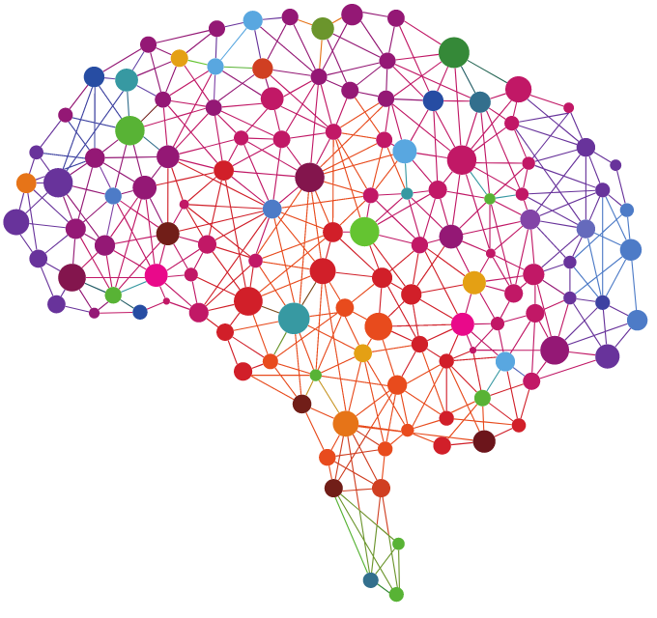
Delhi School of AI
23rd December, 2018: Meetup #1

Slide 2
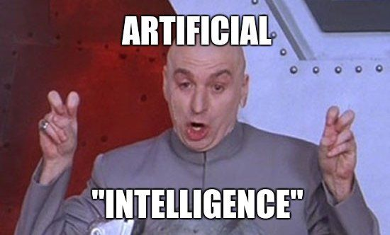

Slide 3

I mean really, what is it?
Simulation of Human Intelligence
Acquisition of Information
Formation of Rules to use such Information
Reasoning through the use of rules
Awesomeness!

Slide 4
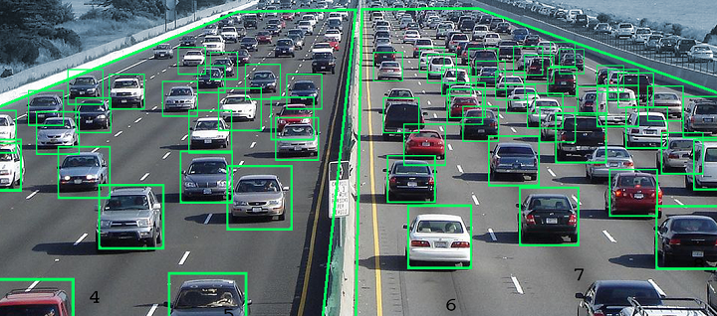
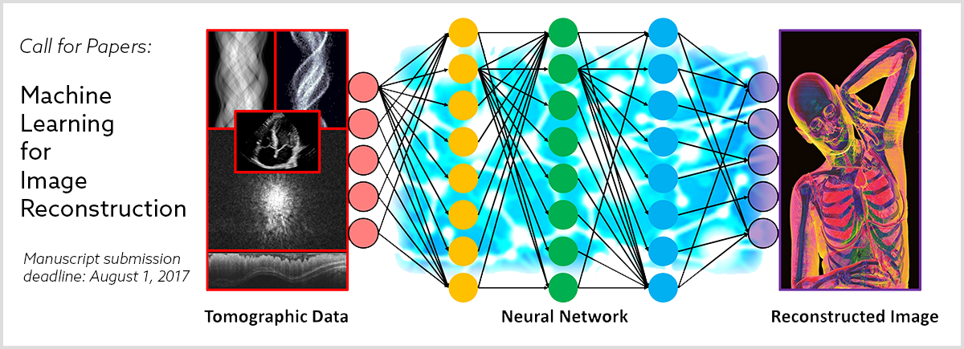




Slide 5


Slide 6
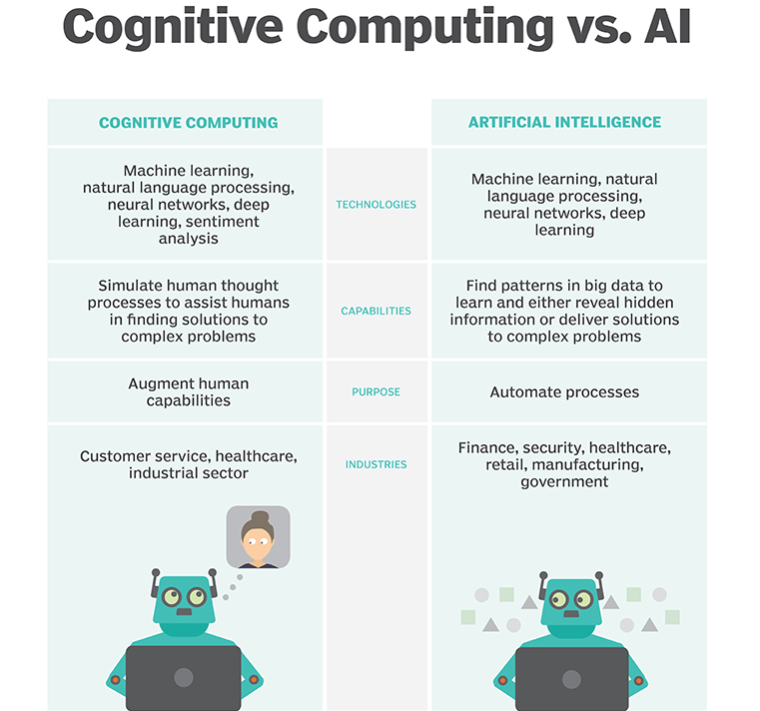

Slide 7


Slide 8








Who are making it happen?

Slide 9






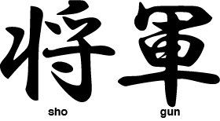




‹#›

Slide 10
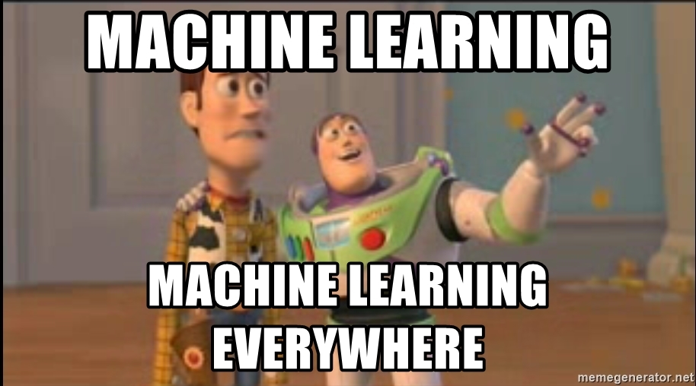

Slide 11


Slide 12

So, where should I start?
Blogs & Articles
Research Papers
MOOCs
Projects
Discussions
Collaboration
Patience

Slide 13



if (talk == “done”)
{
open_jupyter()
}
Numpy
Pandas
Matplotlib
Scikit-Learn
Jupyter Notebook
GitHub:
github.com/delhischoolofai/
Clone GitHub Repository
https://github.com/delhischoolofai/delhischoolofai/tree/master/Meetup_1

